Slide 1

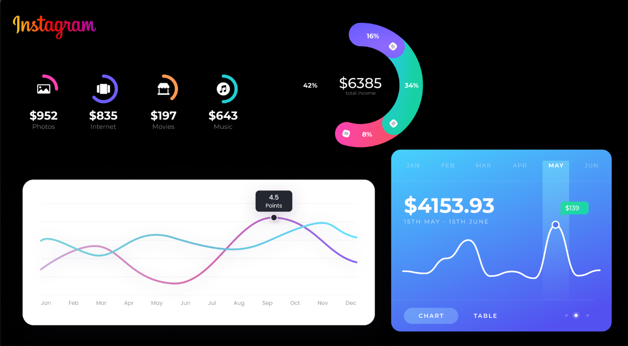

Slide 2
Instagram User Analytics
Description: To keep track of users behavior, engagement, and interaction on the Instagram application, Instagram User Analytics is used. Instagram user analytics specifies the procedure of collecting, analysing, and presenting relevant data related to the user. This information offers valuable insights on the efficiency and success of an individual's or a company's social media presence.
To remarkably improve the app's performance, user experience, and overall success, the valuable insights and data-driven information provided by the analytics are essential for app development. Business teams can then use the acquired information further. The marketing team can use this provided data to launch a new marketing campaign. The product team can use these insights to build a new feature, and the development team can use these insights to improve the overall experience.
Frequently, Instagram User Analytics analyses the following major metrics and data points:
Loyal User Reward
Inactive User Engagement
Contest Winner Declaration
Hashtag Research
Ad Campaign Launch
User Engagement

Slide 3
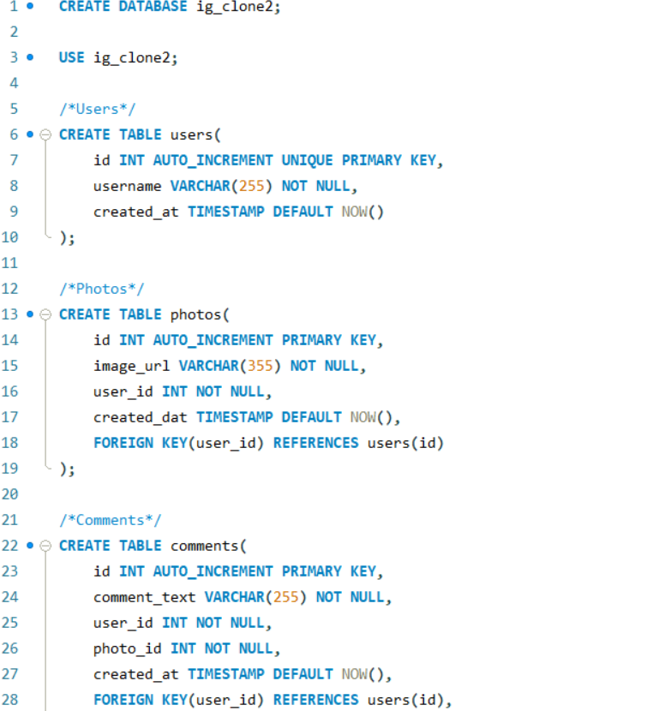
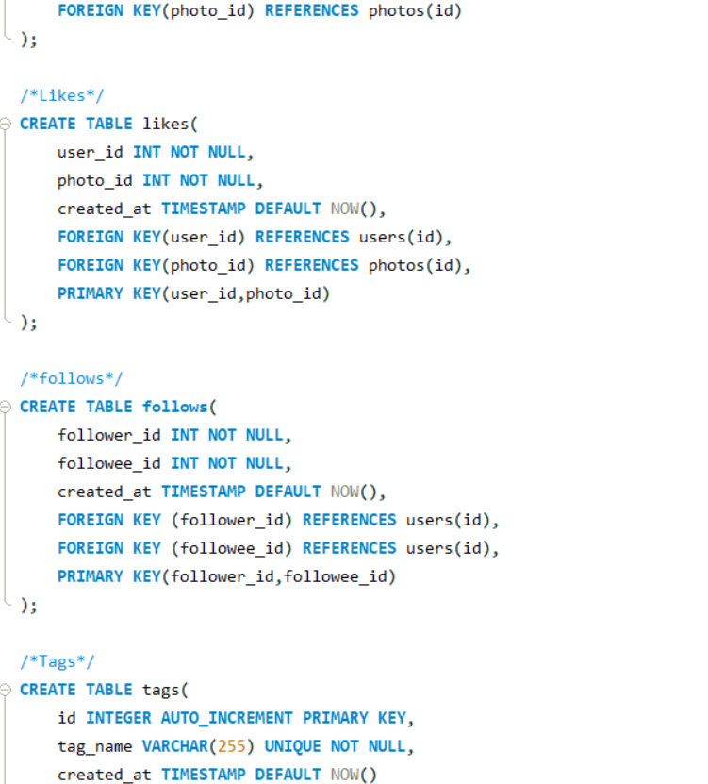
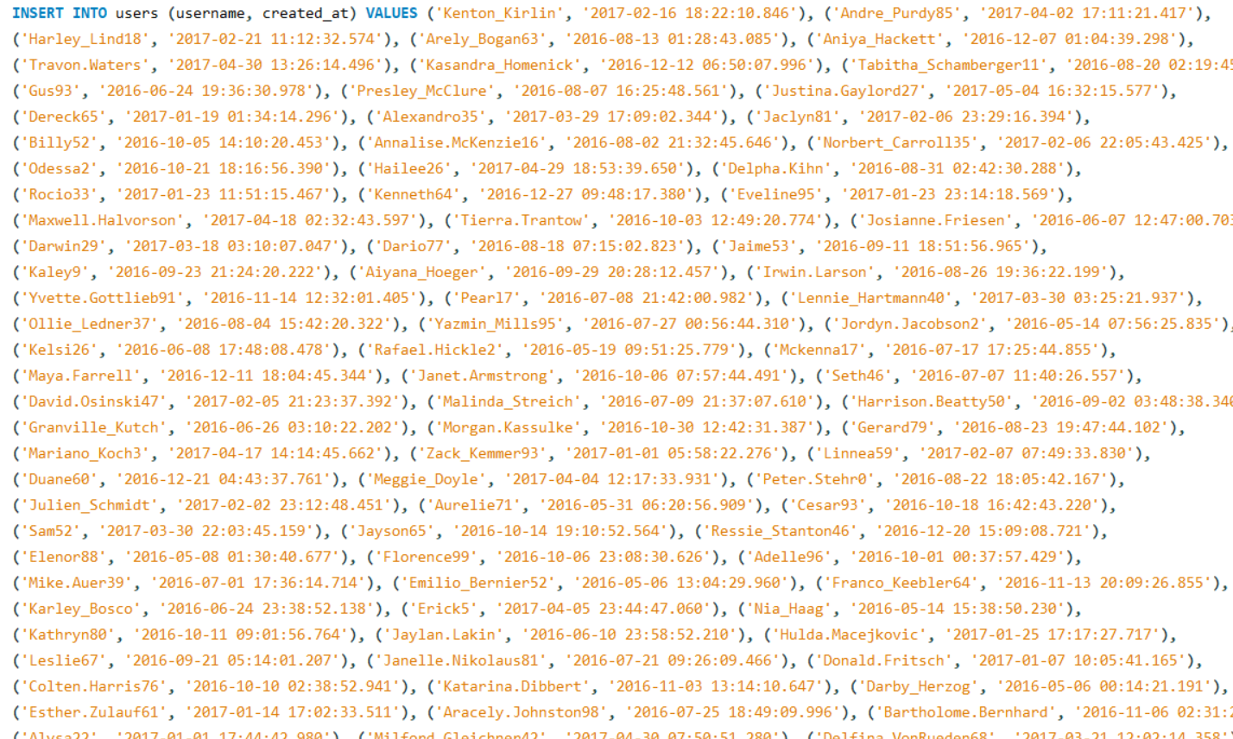
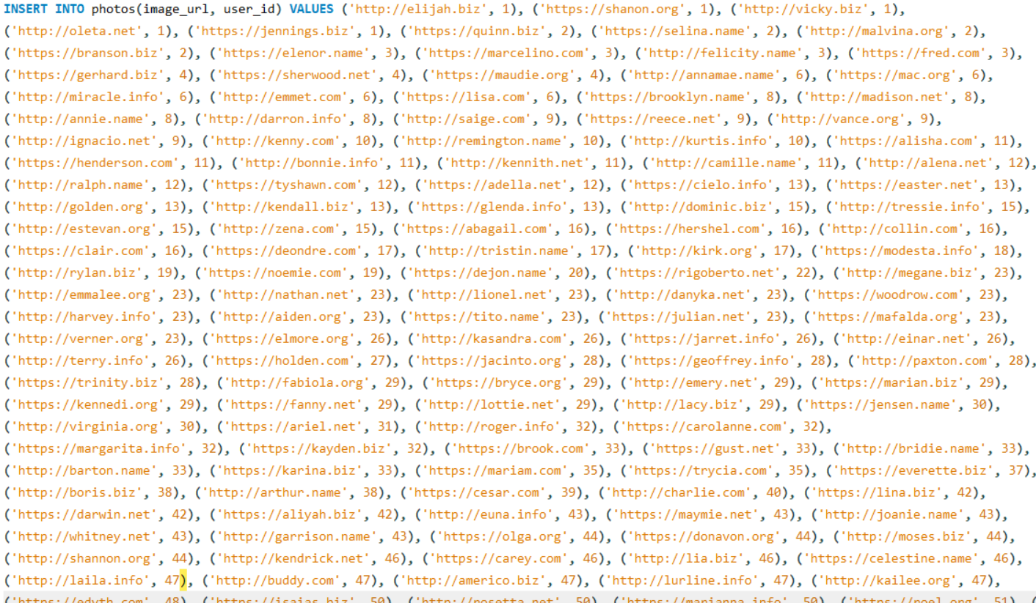
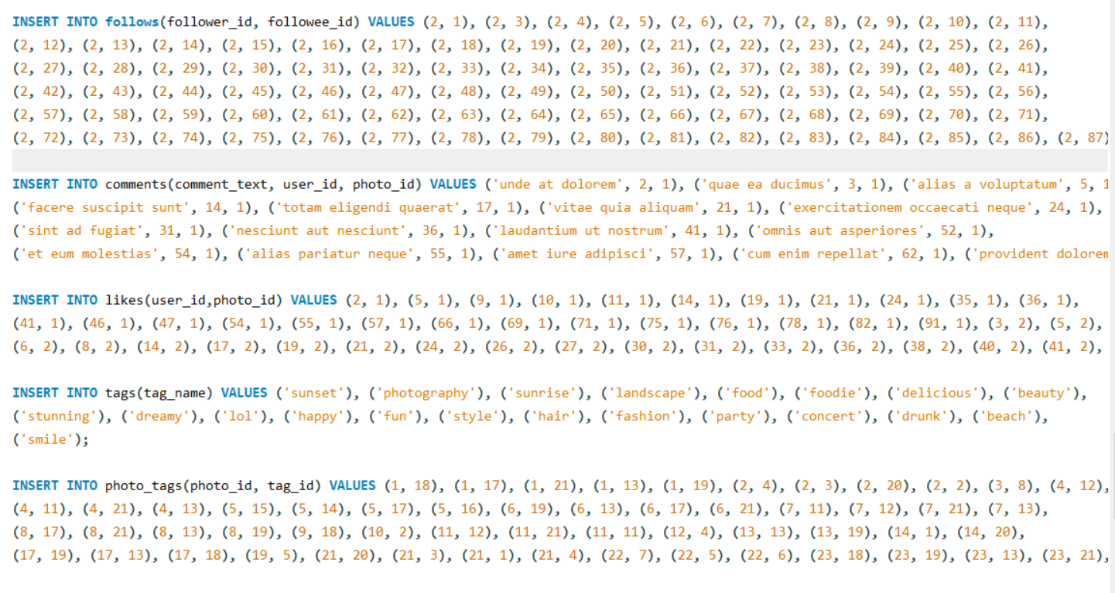
Data Entry in Mysql workbench

Slide 4
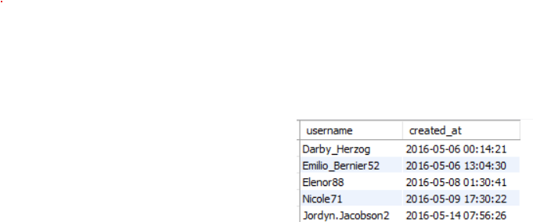
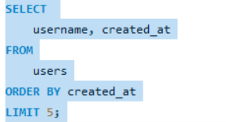
A) Marketing Analysis:
Loyal User Reward: The marketing team wants to reward the most loyal users, i.e., those who have been using the platform for the longest time.
Task: Identify the five oldest users on Instagram from the provided database.
SQL Query :
Result:

Slide 5
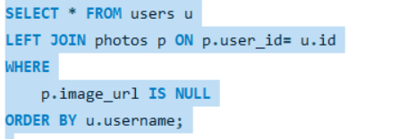
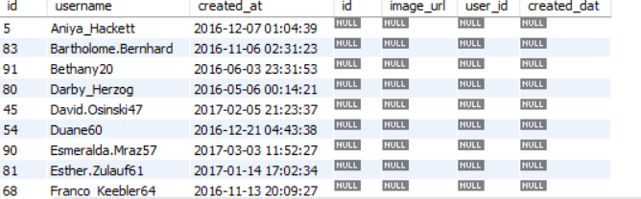
Inactive User Engagement: The team wants to encourage inactive users to start posting by sending them promotional emails.
Task: Identify users who have never posted a single photo on Instagram.
SQL Query :
Result:

Slide 6
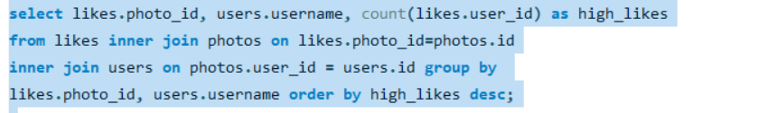
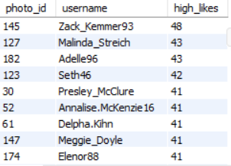
Contest Winner Declaration: The team has organized a contest where the user with the most likes on a single photo wins.
Task: Determine the winner of the contest and provide their details to the team.
SQL Query :
Result:

Slide 7
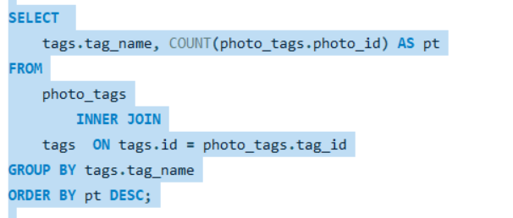
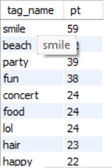
Hashtag Research: A partner brand wants to know the most popular hashtags to use in their posts to reach the most people.
Task: Identify and suggest the top five most commonly used hashtags on the platform.
SQL Query :
Result:

Slide 8
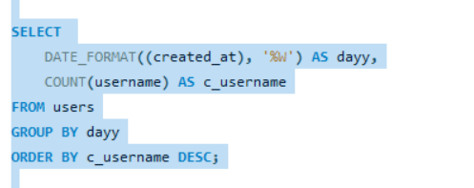
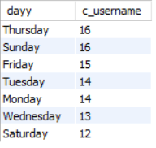
Ad Campaign Launch: The team wants to know the best day of the week to launch ads.
Task: Determine the day of the week when most users register on Instagram. Provide insights on when to schedule an ad campaign.
SQL Query :
Result:

Slide 9
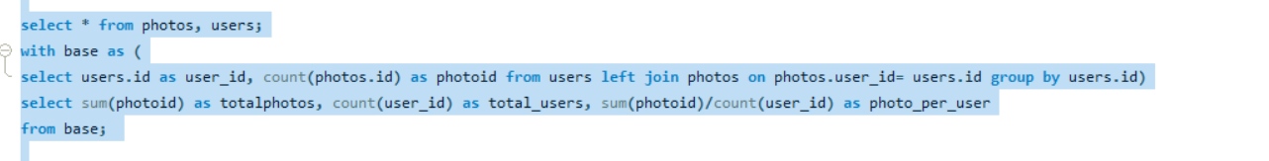

B) Investor Metrics:
User Engagement: Investors want to know if users are still active and posting on Instagram or if they are making fewer posts.
Task: Calculate the average number of posts per user on Instagram. Also, provide the total number of photos on Instagram divided by the total number of users.
SQL Query :
Result:

Slide 10
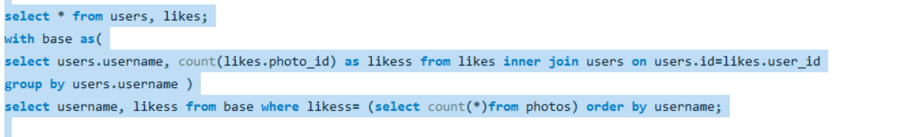
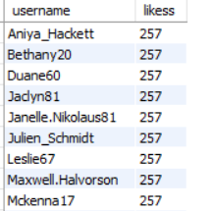
Bots & Fake Accounts: Investors want to know if the platform is crowded with fake and dummy accounts.
Task: Identify users (potential bots) who have liked every single photo on the site, as this is not typically possible for a normal user.
SQL Query :
Result:

Slide 11
Thank You

